Slide 1
Ride Booking Analytics Dashboard
KARTHIKEYAN P

Slide 2
PROJECT OVERVIEW
This project focuses on analysing ride booking data using Power BI to generate meaningful insights about demand patterns, cancellations, and revenue performance.
The dashboard provides an interactive and visual representation of ride-sharing operations to support data-driven decision-making.

Slide 3
PROBLEM STATEMENT
Ride-sharing platforms generate large volumes of data, but without proper analysis, it is difficult to:
Identify peak demand periods
Understand cancellation behavior
Track revenue performance
Improve operational efficiency

Slide 4
IMPORTANCE OF THE PROJECT
Helps in reducing ride cancellations
Improves customer experience
Identifies high-demand locations and peak hours
Supports business decision-making
Demonstrates real-world data analytics skills

Slide 5
DATASET DETAILS
Source: Kaggle (Ride Booking Dataset)
Size: 100,000+ records
Data includes:
Booking ID
Date & Time
Pickup Location
Vehicle Type
Ride Distance
Booking Value
Status (Success, Cancelled, etc.)
Payment Method
Ratings

Slide 6
TOOLS & TECHNOLOGIES USED
Excel – Initial data handling
Power Query – Data cleaning & transformation
Power BI – Dashboard creation & visualization

Slide 7
DATA PROCESSING WORKFLOW
Data Collection
Collected raw dataset from Kaggle
Initial Data Handling (Excel)
Opened dataset in Excel
Performed basic inspection
Checked for missing values and inconsistencies
Removed obvious unnecessary columns
Data Import into Power BI
Loaded dataset into Power BI
Data Cleaning & Transformation (Power Query)
Removed unwanted columns
Handled null values and errors
Corrected data types (Date, Time, Numeric)
Renamed columns for consistency

Slide 8
Feature Engineering
Created new columns:
Hour
Day of Week
Status categories
DAX Measures Creation
Total Rides
Total Revenue
Cancellation Rate
Average Fare
Revenue per Ride
Dashboard Development
Built multi-page dashboard
Added KPIs, charts, slicers
Applied formatting and layout
Insight Generation
Identified trends and patterns
Derived business insights

Slide 9
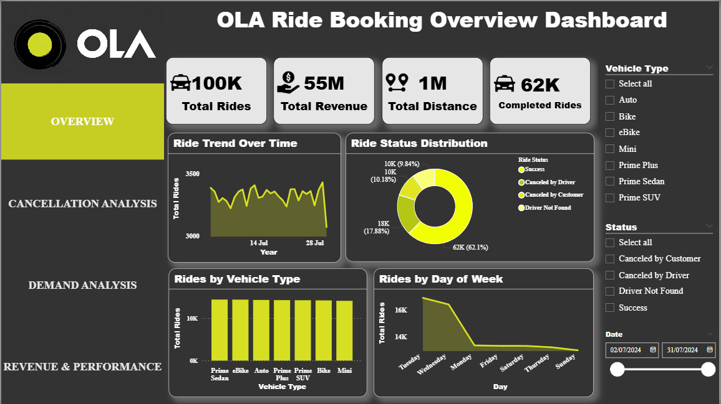
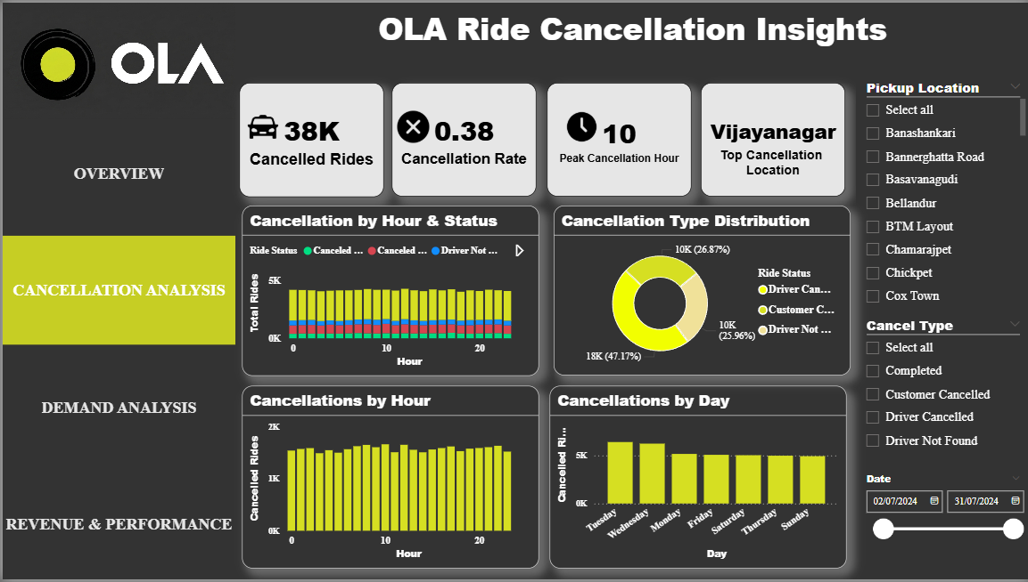
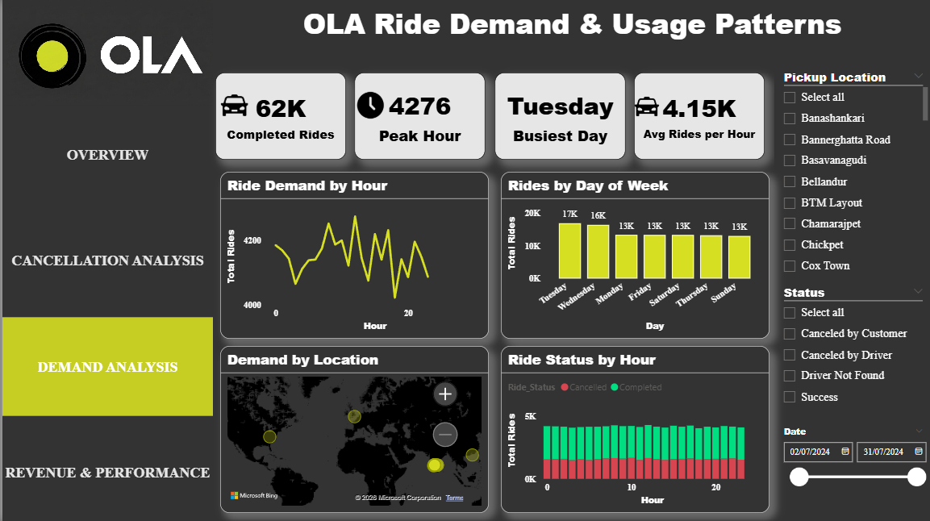
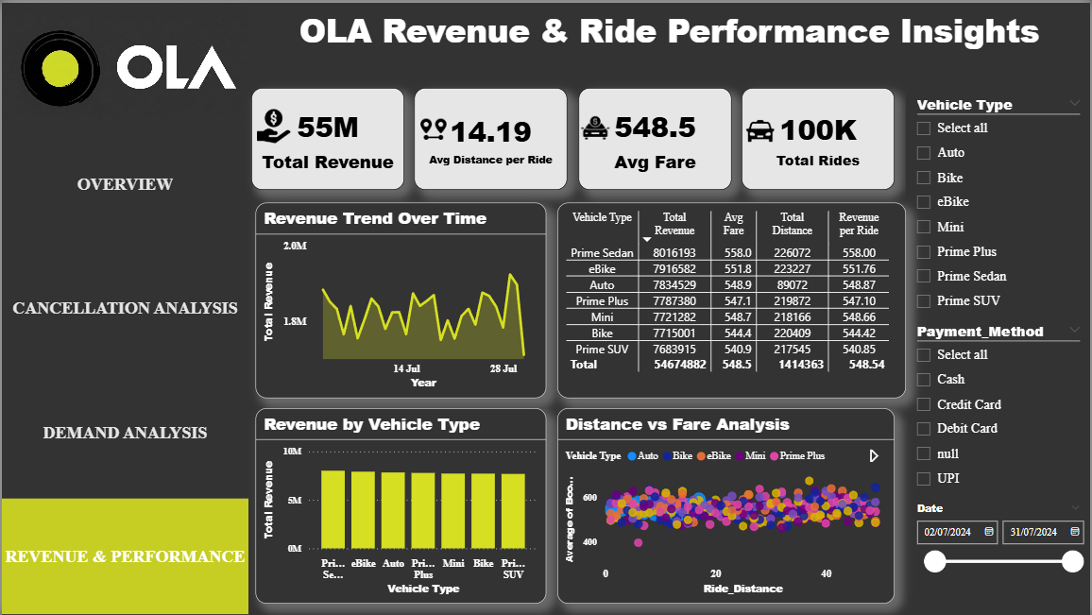
DASHBOARD PREVIEW
Overview
Cancellation Analysis
Demand Analysis
Revenue & Performance

Slide 10
KEY INSIGHTS
Majority of rides are successfully completed
Peak demand occurs during specific hours
Certain locations have higher cancellation rates
Driver-side cancellations are significant
Revenue increases with ride distance and varies by vehicle type

Slide 11
FUTURE ENHANCEMENT
Add demand forecasting using predictive analytics
Improve dashboard UI/UX
Integrate real-time data
Apply machine learning for cancellation prediction

Slide 12
CONCLUSION
This project demonstrates how raw ride booking data can be transformed into meaningful insights using Power BI.
It highlights the importance of data analytics in improving operational efficiency and decision-making in ride-sharing services.

